Slide 1


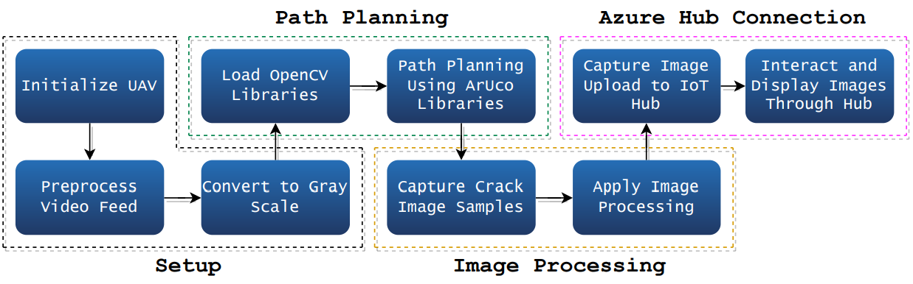
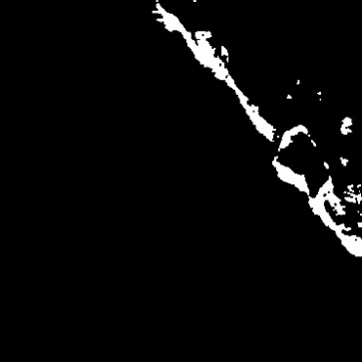
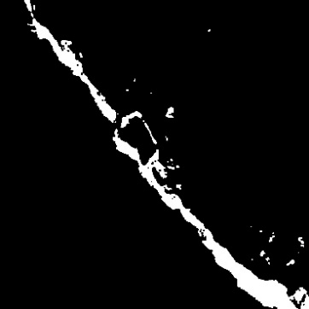
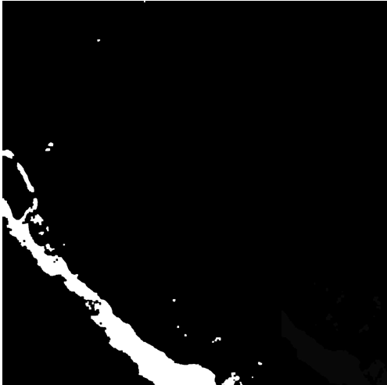
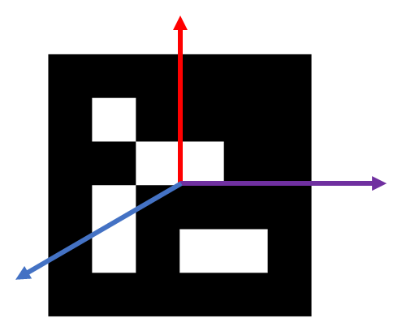
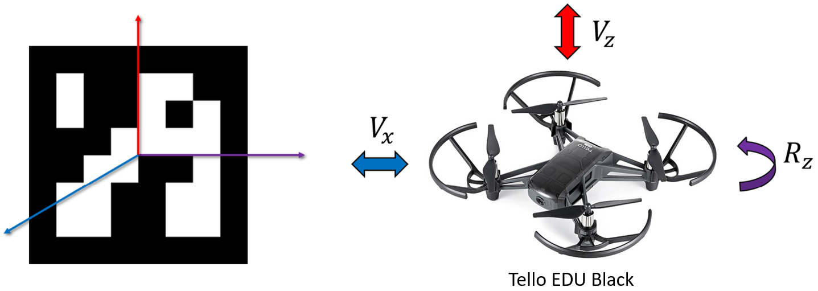
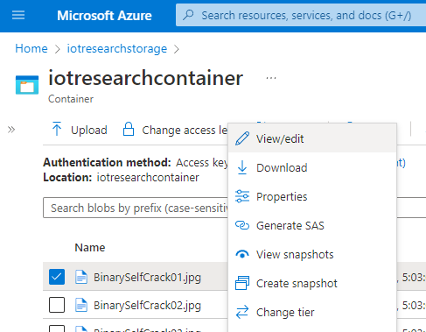
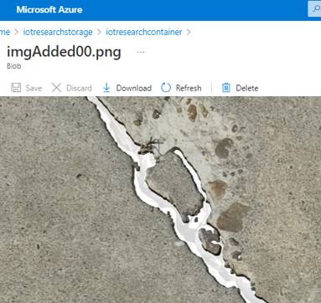
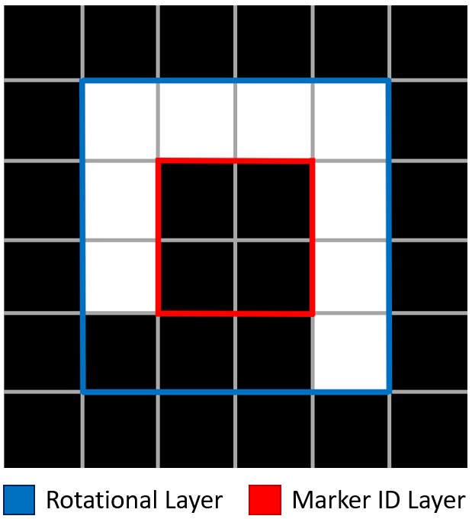
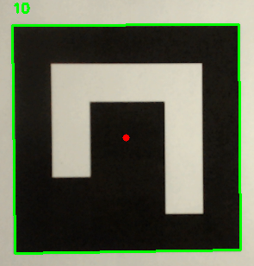
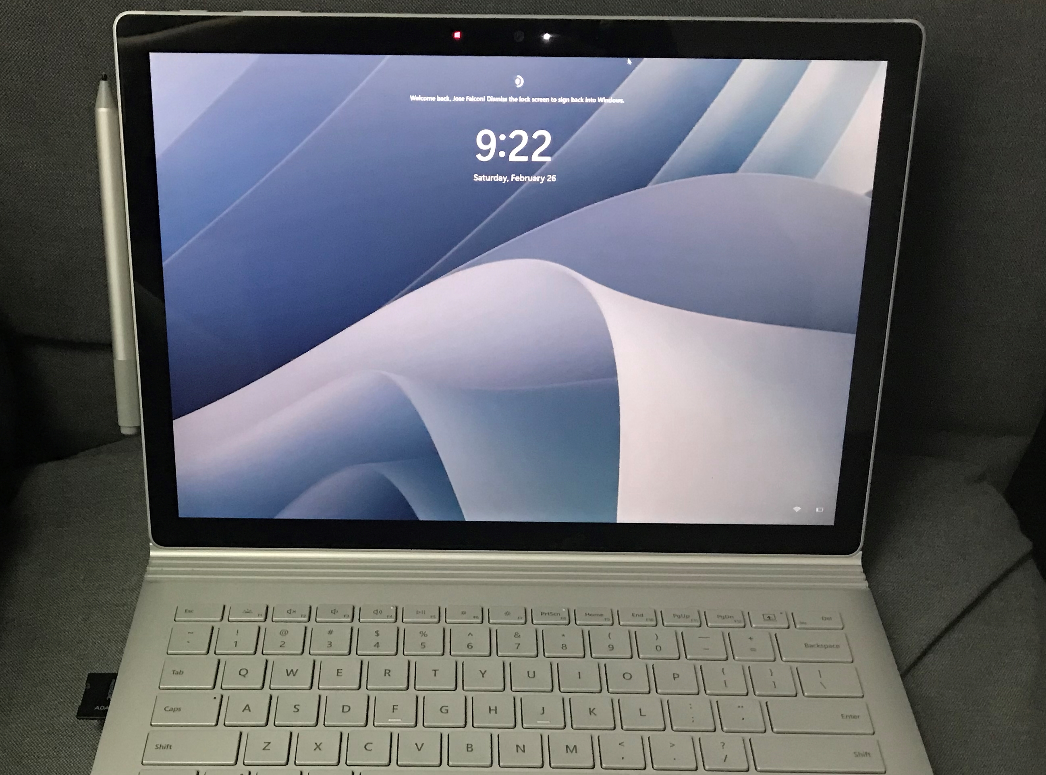
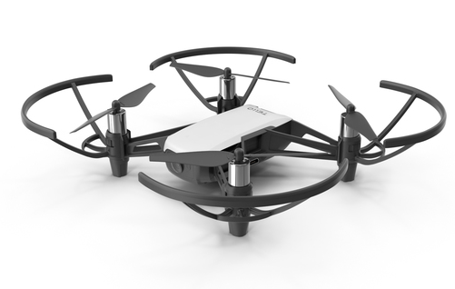
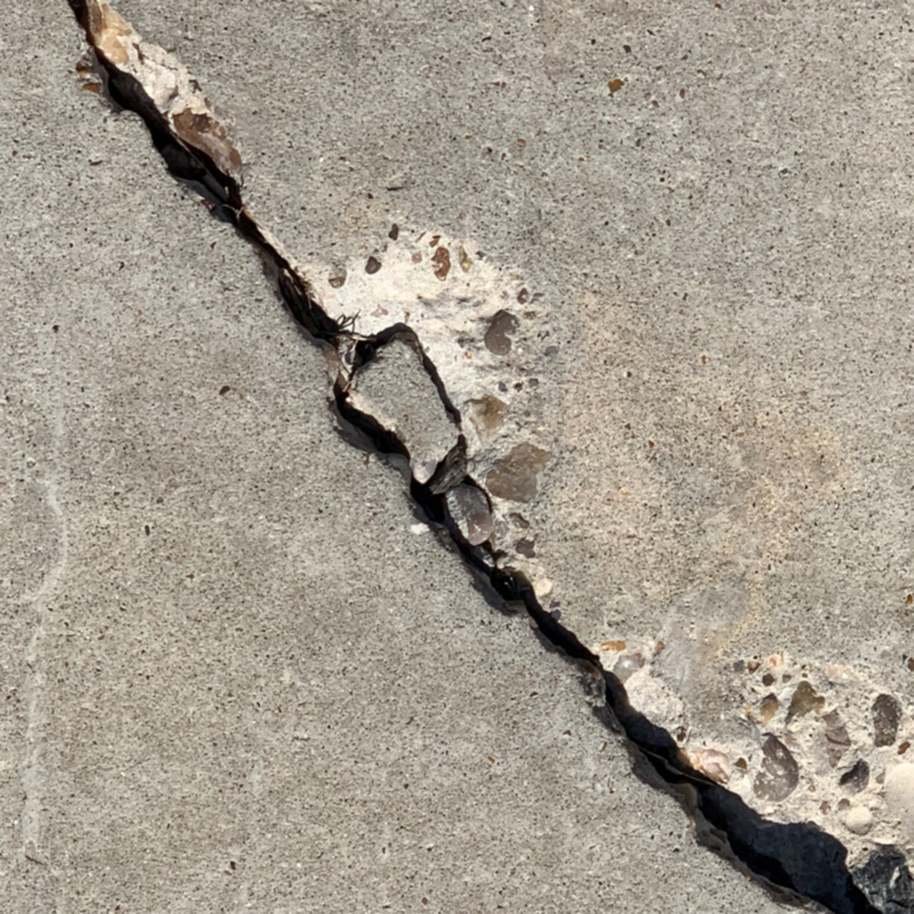
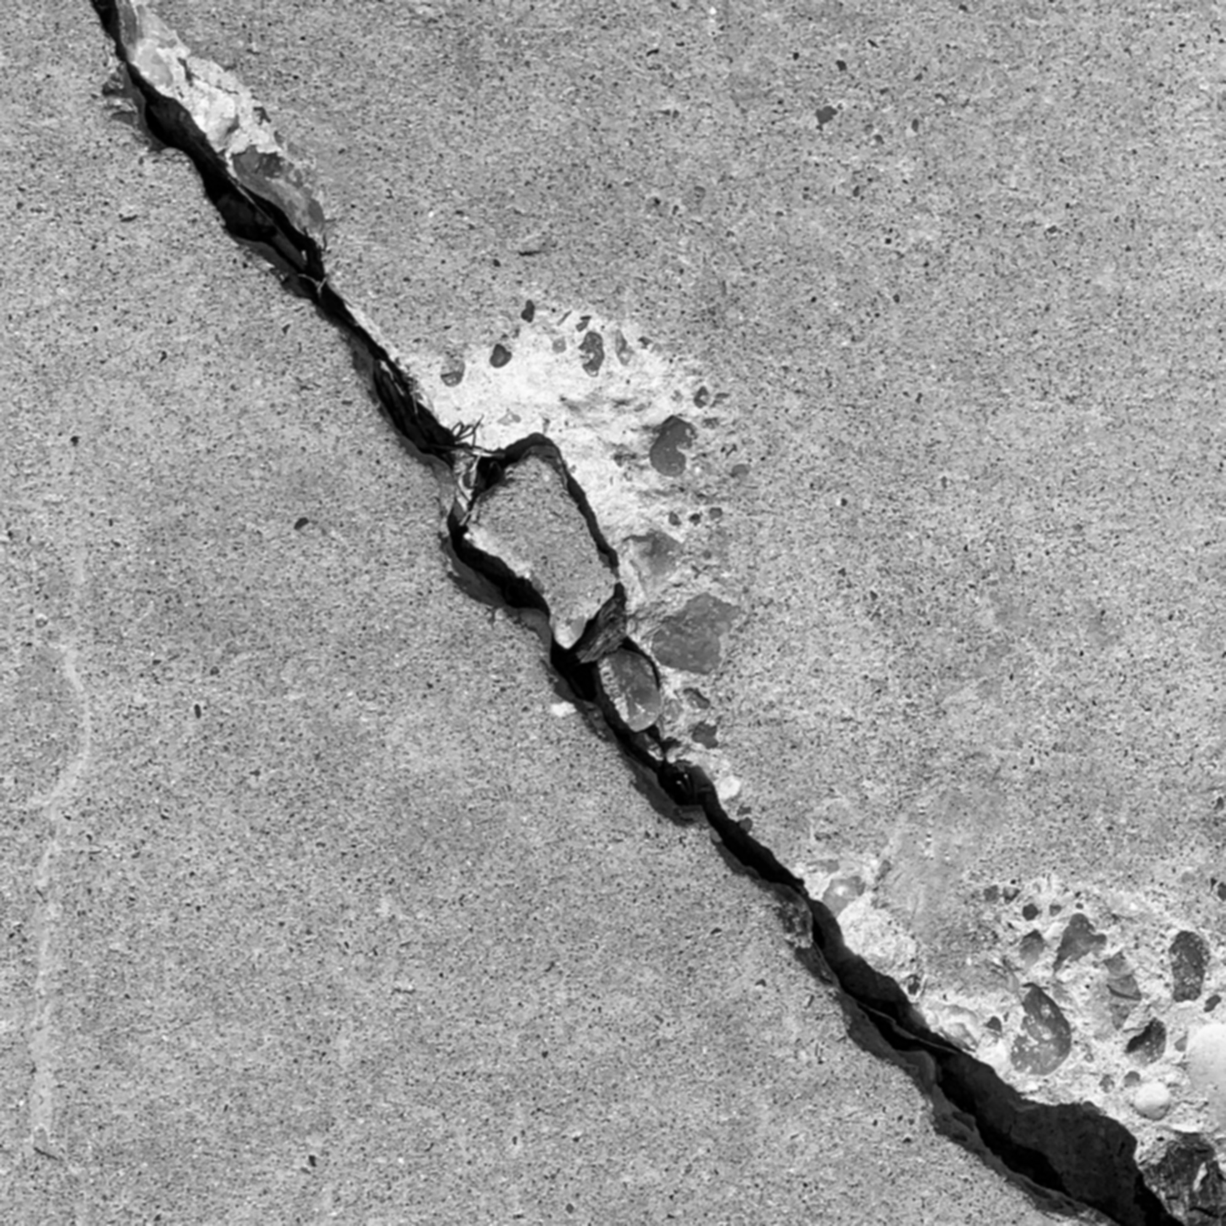
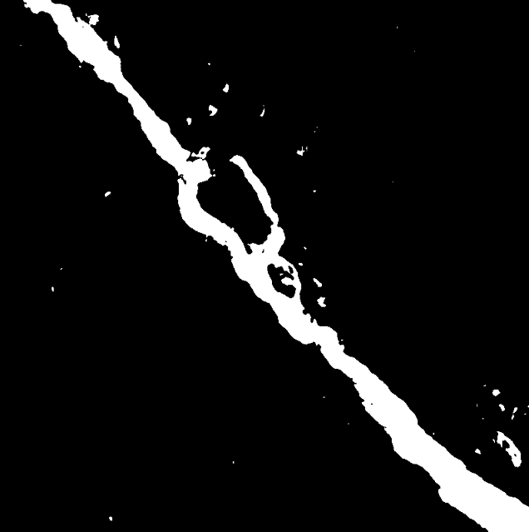

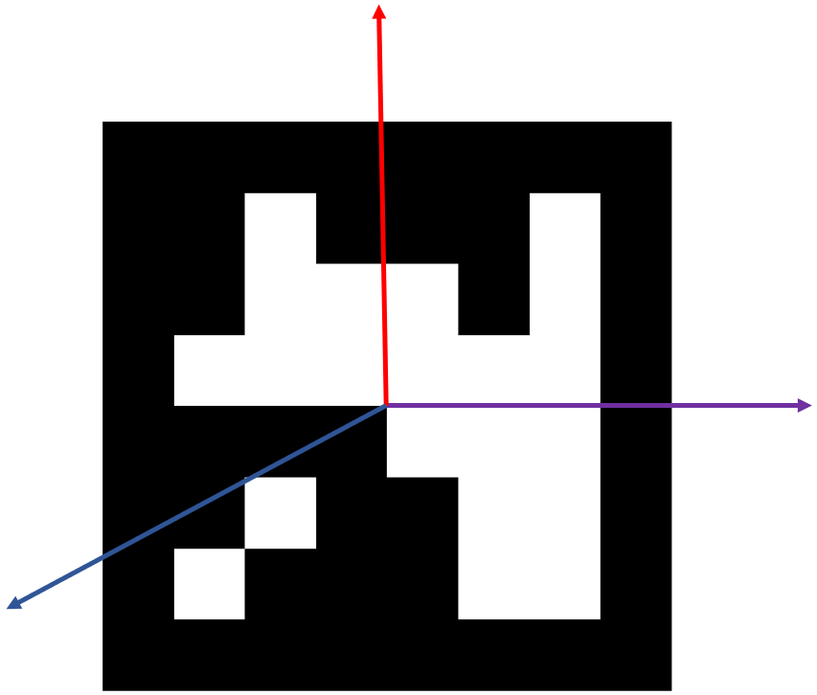
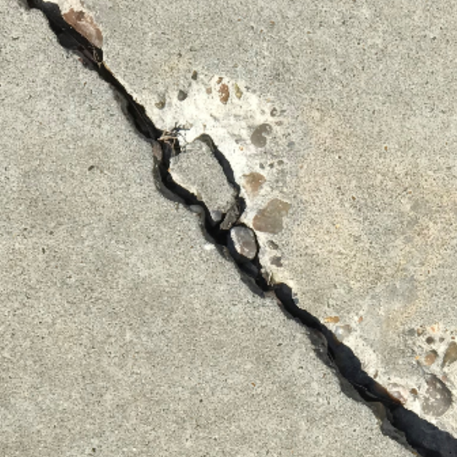
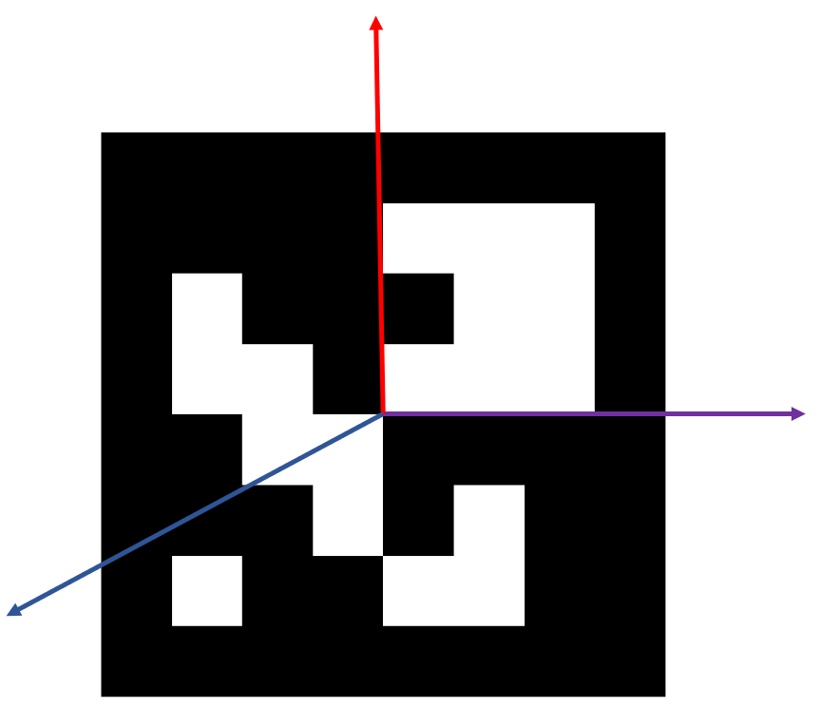
Image Processing through ArUco Marker Instruction in a UAV System and IoT Application
Jose Falcon¹*, Pablo Rangel¹, Mehrube Mehrubeoglu¹
¹ Department of Science and Engineering, College of Electrical Engineering Texas A&M University - Corpus Christi
Abstract
Methodology
Results
The use of location and instruction markers for path planning in any set of unmanned aerial system's tasks is crucial to the effectiveness of the individual unmanned aerial vehicles (UAVs). This research implements OpenCV algorithms that allow a UAV to use ArUco markers to receive data related to location and instruction for the purposes of operation. OpenCV algorithms are utilized to develop vision-based solutions to enhance the capabilities of the UAV. The goal for the UAV's operation includes image capture and image processing of objects using ArUco markers for instruction. The use of ArUco markers also increases the effectiveness of object detection for image capture by guiding the UAV. Some image processing techniques included in the experimentation are line contouring, erosion, and dilation where object detection and isolation are possible. This project utilizes OpenCV and Python libraries for the UAV's instructional operation where image processing techniques are implemented on images that are transmitted over the network infrastructure as an application of Internet of Things (IoT).
Figure 2. Setup, Path Planning & Processing, Azure IoT Hub Block Diagram
Figure 3. UAV Navigation and Coordination Systems
Figure 6. Image Processing for Concrete Damage
Crack sample images will be blurred, and gray scaled before being turned into binary images. Then processing like erosion and dilation will be applied to the binary images to reduce noise and increase clean crack area.
Processed Image at t₁
Processed Image at t₂
Processed Image at t₃
Image capture interval | ~ 2 s
Duration of image processing / frame | ~ 0.01 s
Figure 6. Real-Time Image Processing
Introduction
Automated structural damage inspection is selected as application case study.
The system is based on the camera/vision sensors of the unmanned aerial vehicle and performs real-time image processing.
Visual markers (ArUco) are used as instructional tags for the UAV system’s navigation.
IoT is implemented to displaying the structural damage assessment results via the network infrastructure as an application of IoT.
Figure 7. Microsoft Azure Container
Conclusion
In this work we have successfully demonstrated a system that allows for UAV navigation based on ArUco markers with results of image processing techniques applied to detect cracks as objects of interest (defects) in images of concrete, with the an IoT interface.
Future work will include determining accuracy of path planning with motion capture devices, and additional methods of creating path planning guidance for UAV navigation.
Setup
Figure 4. Marker Classification
Figure 5. Real-Time Marker Identification
Wi-Fi
UAV Network Router
Tello SDK
Image Capture with UAV
Gray-scale Conversion
Binary Image
Acknowledgements
Surface Book Pro
Image Processing
This project is funded in part by the McNair Scholars
Program at Texas A&M University-Corpus Christi.
IoT Hub
References
[1] W. Wu, at al., “Coupling deep learning and UAV for infrastructure condition assessment automation,” in 2018 IEEE International Smart Cities Conference (ISC2), 2018.
[2] Wang, Y., et al. (2020). An improved ArUco marker for monocular vision ranging. 2020 Chinese Control And Decision Conference (CCDC).
ArUco Marker 10
Crack Sample
ArUco Marker 0
Figure 1. Simulation Setup / IoT Hub Connection

